Slide 1
Etcetera Map
Putting your unconventional objects on a map
Goh Zongye Benjamin (U2022728L)
Notes:
Hi, I’m Benjamin and thank you for listening to my presentation for my project, EtceteraMap.

Slide 2


Notes:
When you’re out, have you ever been thirsty and wondered where a nearby water fountain could be? Or in my personal experience, if any vending machines were nearby.

Slide 3
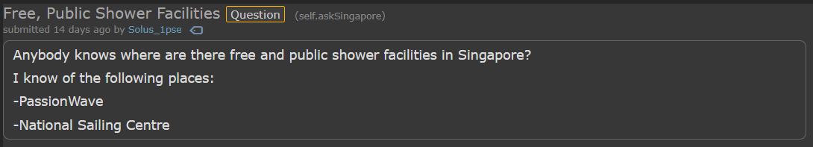
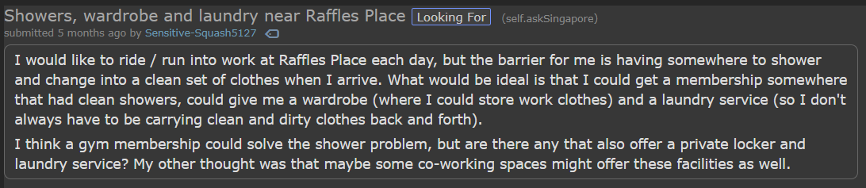
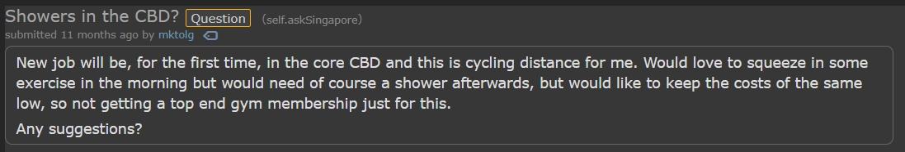
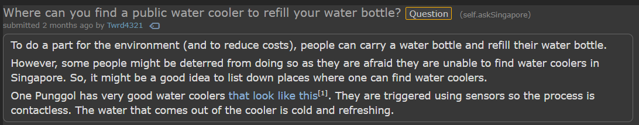
Notes:
It’s not just me who wonder these things, even people ask about places like public showers.
All of the places listed aren’t conventionally mapped on platforms like Google or Apple maps, because why would they?
Stuff like water fountains, vending machines and public showers aren’t exactly something you would think of when asked about a landmark.
But how else would people find such things?

Slide 4
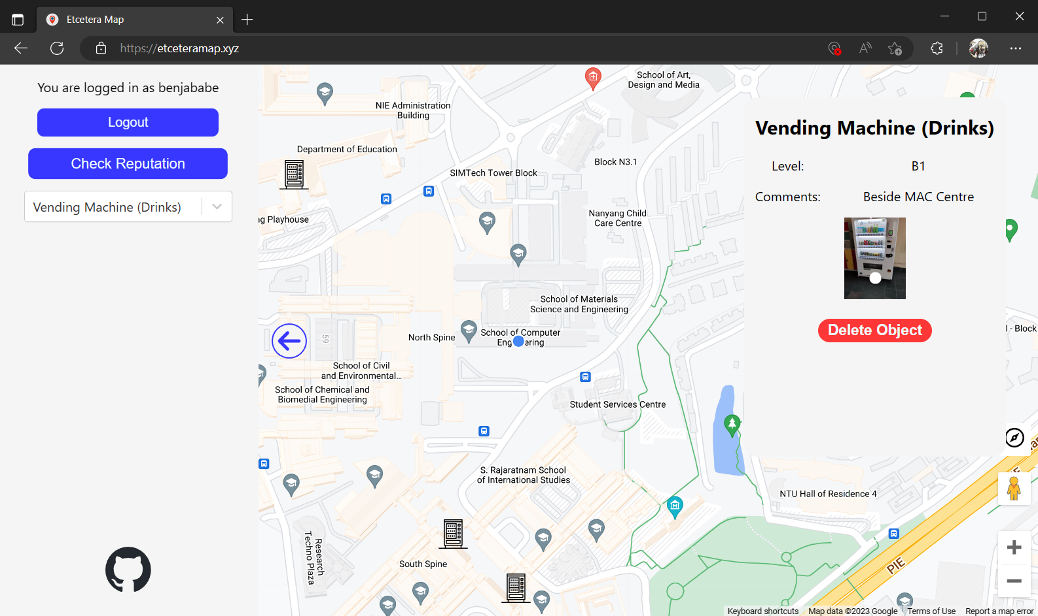
Notes:
This is where my project comes in, EtceteraMap. EtceteraMap is a software as a service where users will be able to view locations of typically non-landmarked objects or locations.
All locations will either be crowdsourced from users or attained from authorised figures, such as distributors in the case of vending machines.

Slide 5
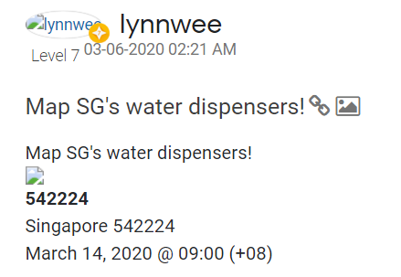
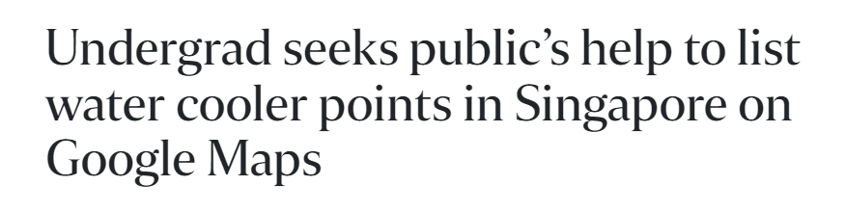
Notes:
Mapping water fountains itself is not a novel concept, it has been suggested in the past but with no real traction.
And more recently, while I was developing this project, another student has been creating a water fountain map within Google Maps itself.
EtceteraMap however does not limit itself to water fountains, but also includes its own user reputation system.

Slide 6


Notes:
EtceteraMap was built with the PERN stack as I had some experience with each individual component, saving a ton of time not having to learn something entirely new for this project.
It’s currently being hosted on AWS, using services like their Cloud VM & database, DNS service and SSL certificate distributor.

Slide 7
Notes:
Adding a location is simple enough, just tap or click on the map and the marker and button below will show up.
Click on it and a popup will appear where you can fill in additional information.
On submission, the marker will appear on the map though to show the newly added images it requires a refresh.

Slide 8
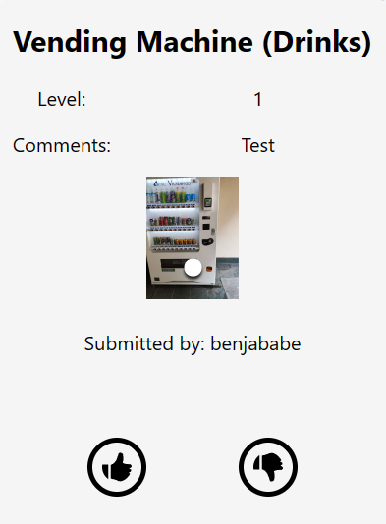
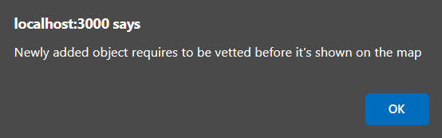
Notes:
But how do I handle verification of users or their locations? Referring to the user reputation mentioned earlier, users are able to vote on object markers.
These votes will be taken into consideration among other variables, the submitter’s reputation score.
Currently, the reputation threshold for a “verified” user is 5 but that is subject to change as the user base isn’t large enough to reach a proper value.

Slide 9
User Reputation
Sum of score of votes from voter to submitter
Reputation score of voter
Sum of score of votes of submitter
Number of votes made by submitter
Notes:
The user reputation for a submitter uses these 4 variables currently:
The sum of score of votes from one voter to the submitter
Reputation of the voter
Sum of score of votes of the submitter
and the number of votes made by the submitter.
This goes for all voters for the submitter, a more in-depth explanation is in the project report and excluded here to reduce presentation boredom.

Slide 10
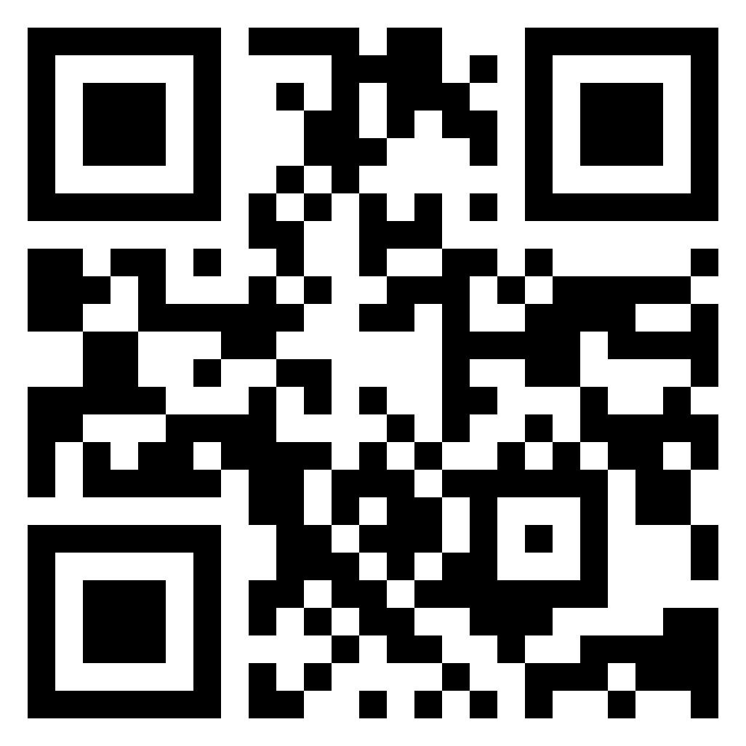
Thank You
Notes:
With EtceteraMap, I hope users will be able to find stuff where they wouldn’t otherwise, without hassle in their user experience.
Thank you all for listening and there is a QR code to EtceteraMap, hope you try it out.

